Slide 1
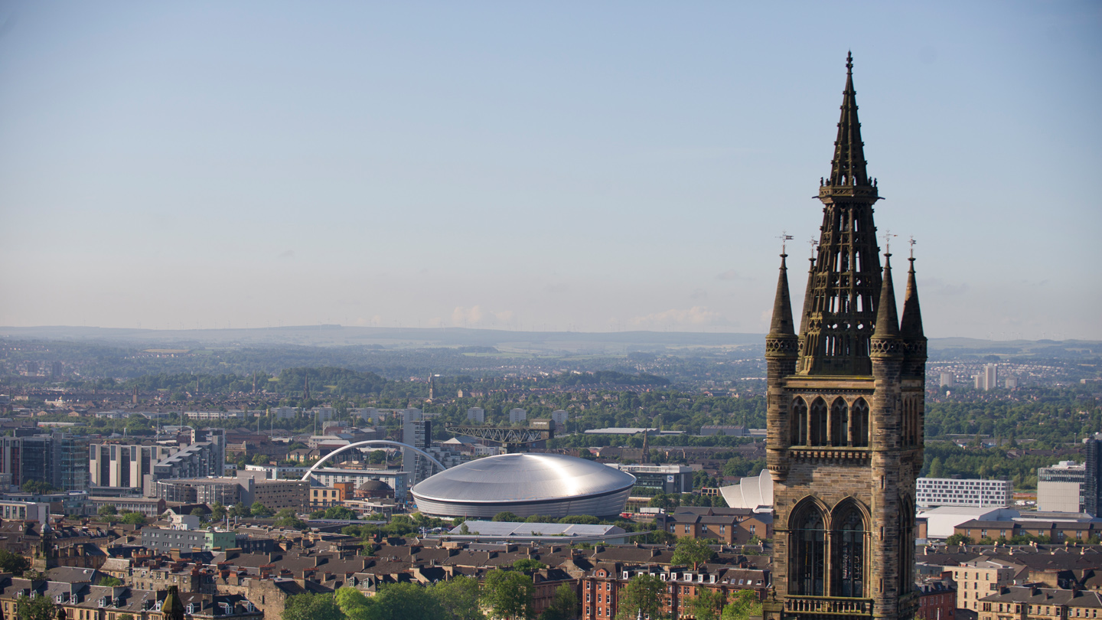

Virtual Heritage App
Frances Ramirez (2168154)

Slide 2
Aims and Objectives
Mobile VR application
The Tall Ship, Glenlee
Spread knowledge
Change visitation intentions

Slide 3
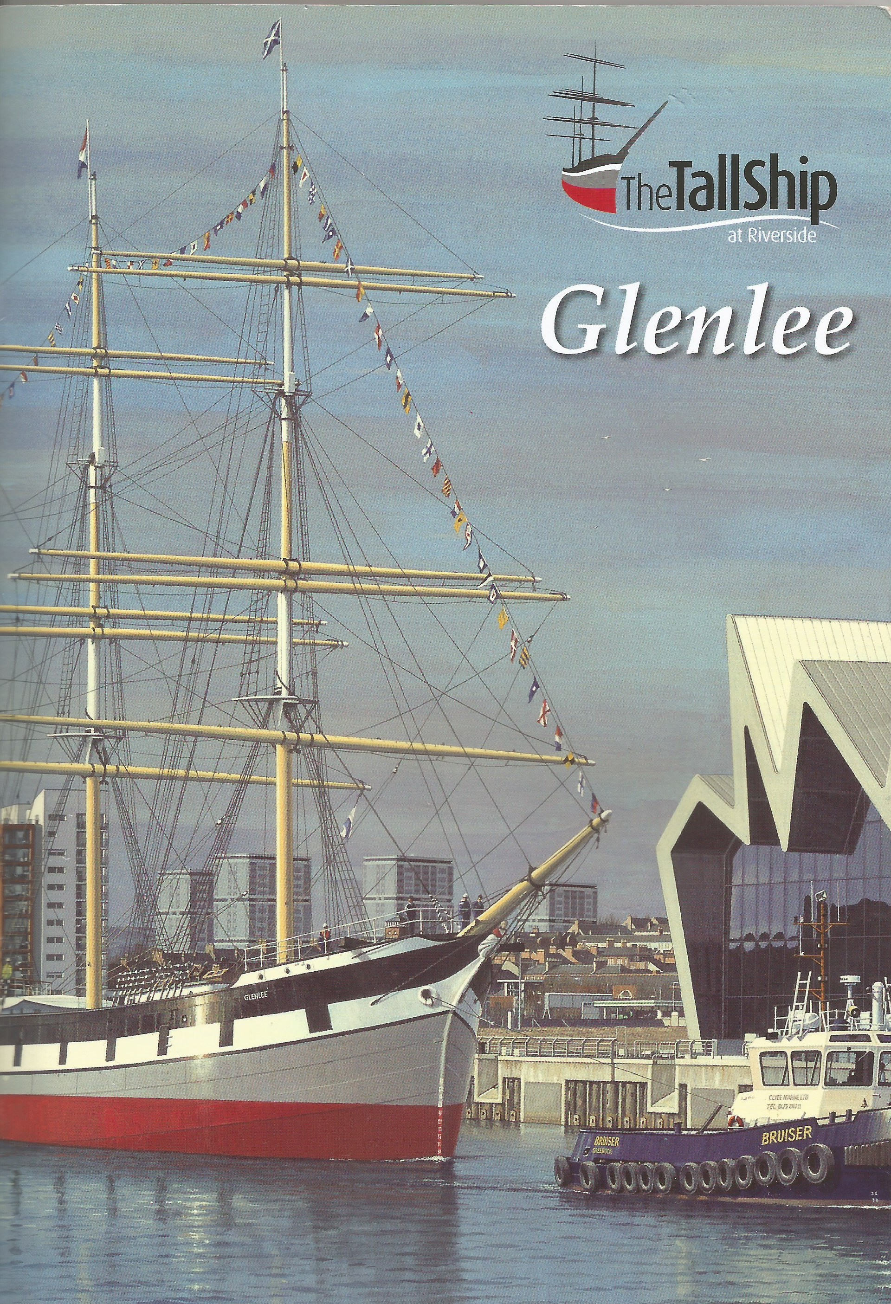
Project Lifecycle
Literature Review
Field Study
Requirements
User Stories, MoSCoW method
Development
Unity, C#, Daydream View VR
Evaluation

Slide 4
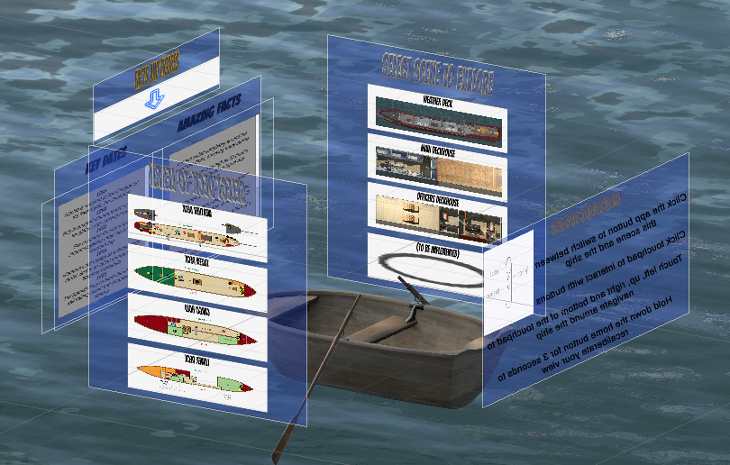
Design
Map Scene (“The Main Menu”)
Implemented three areas
Weather Deck
Officers’ Deckhouse
Main Deckhouse
Open/Closed Principle
Demo…

Slide 5
Design - Map Scene
“The Main Menu”

Slide 6
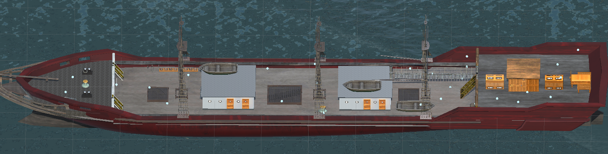
Design - Weather Deck
The exposed deck of the ship

Slide 7
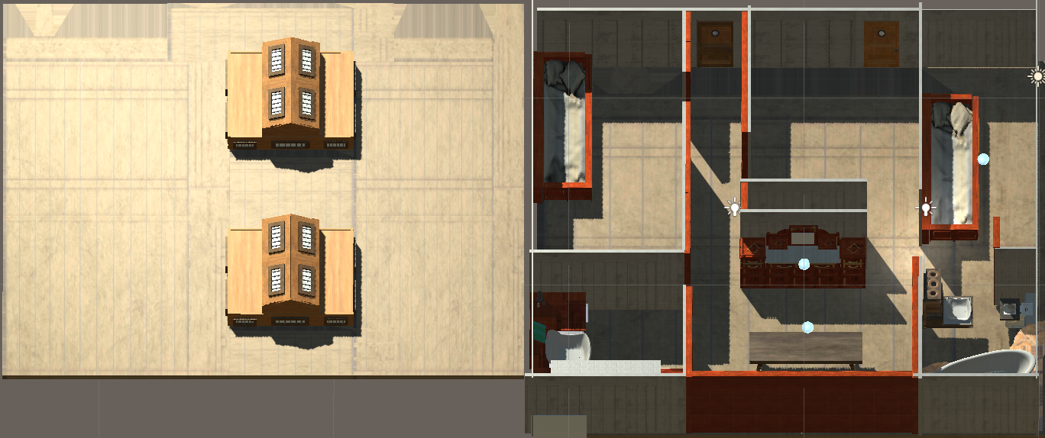
Design - Officers’ Deckhouse
The Captain’s and Apprentices’ office, living room when they were at sea.

Slide 8
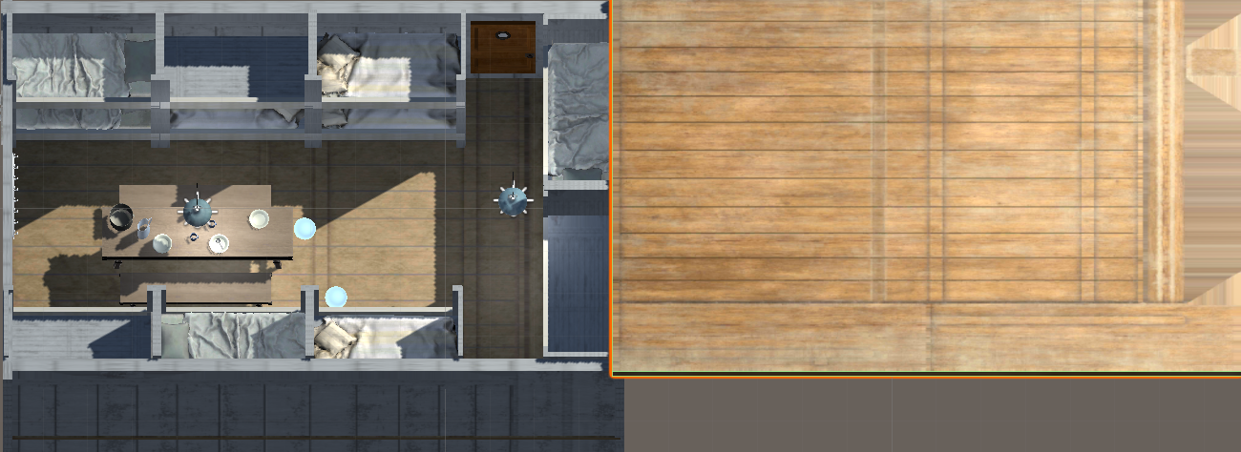
Design - Main Deckhouse
Where 16 crewmen, not officers, lived while at sea.

Slide 9
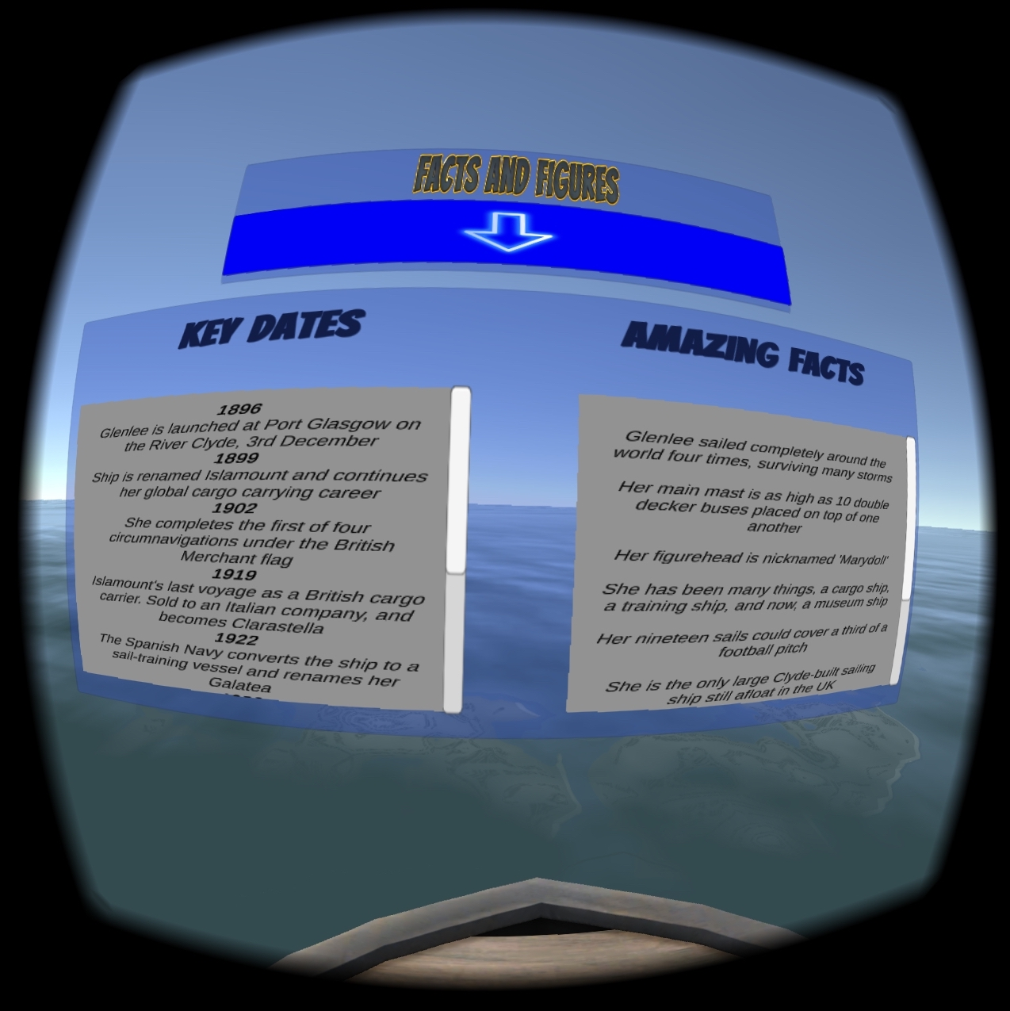
Spreading knowledge in the map scene

Slide 10
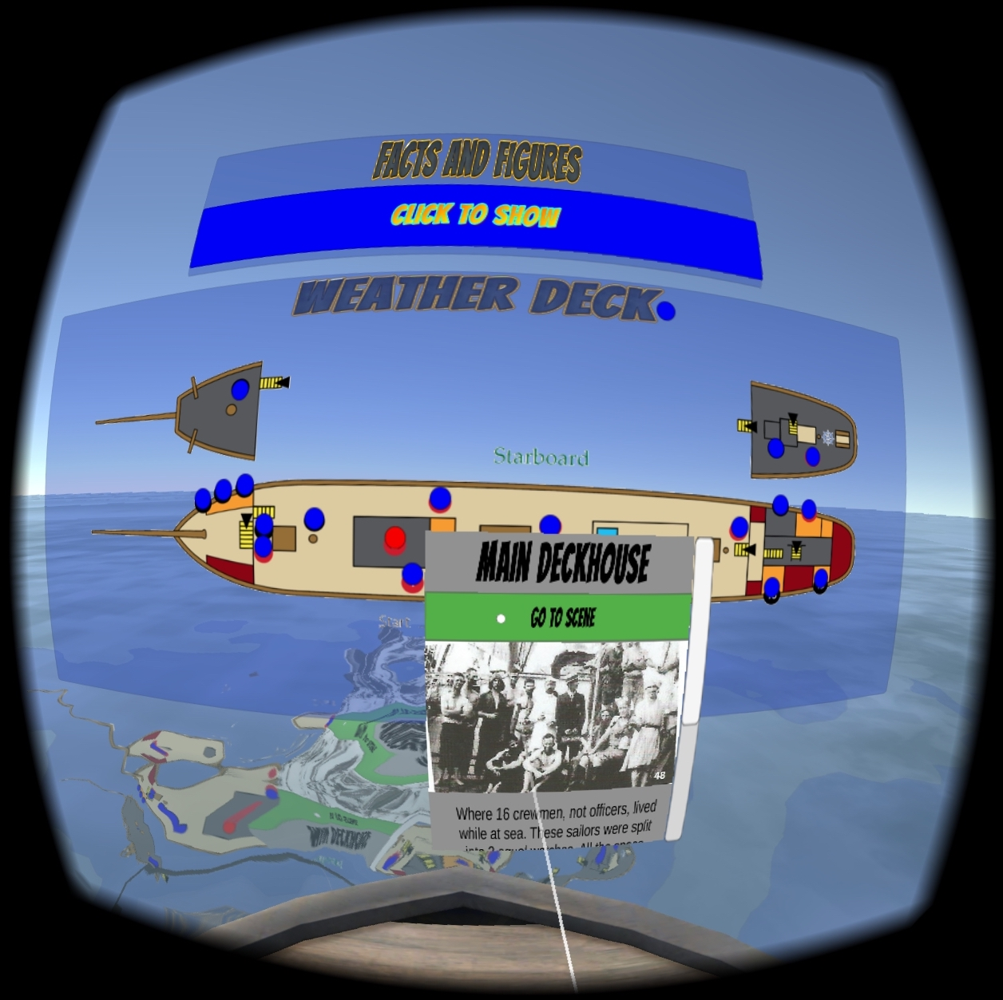
Spreading knowledge in the map scene

Slide 11
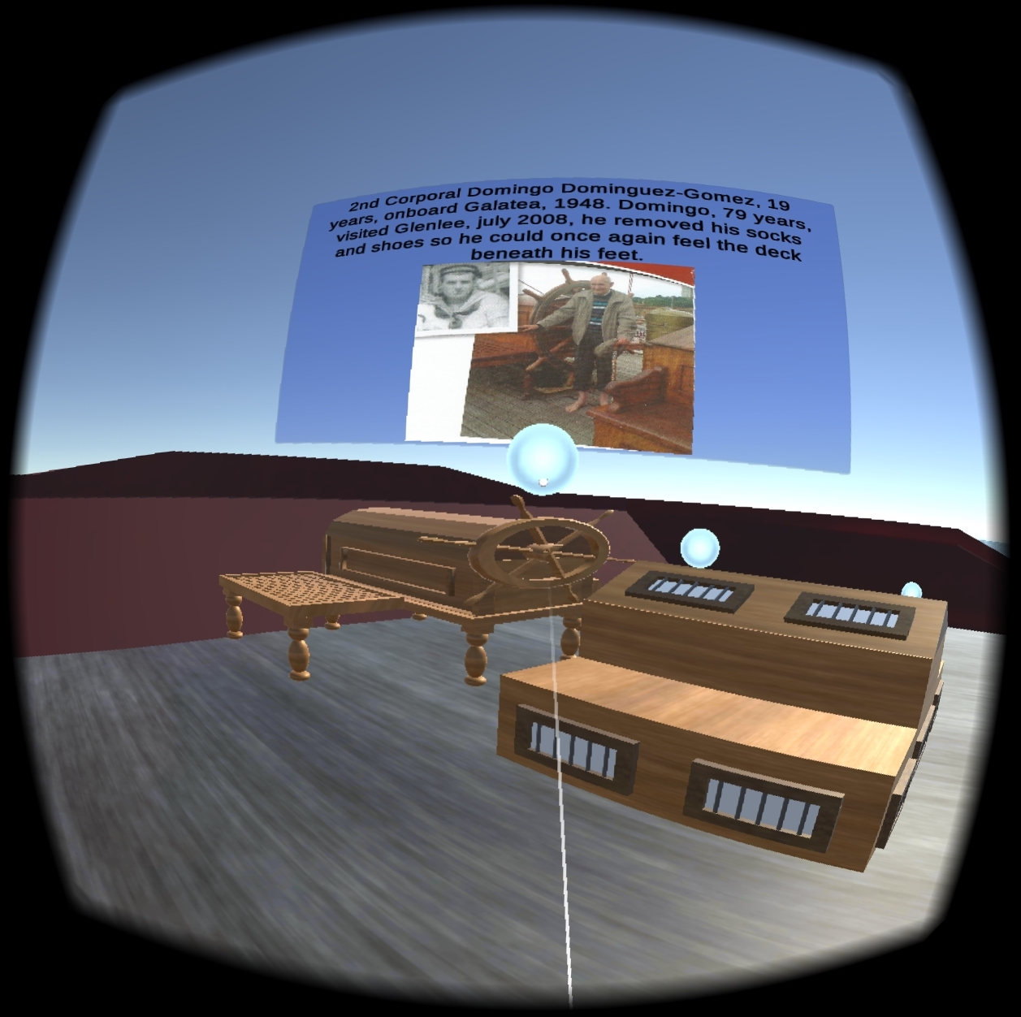
Spreading knowledge in the virtual weather deck scene

Slide 12
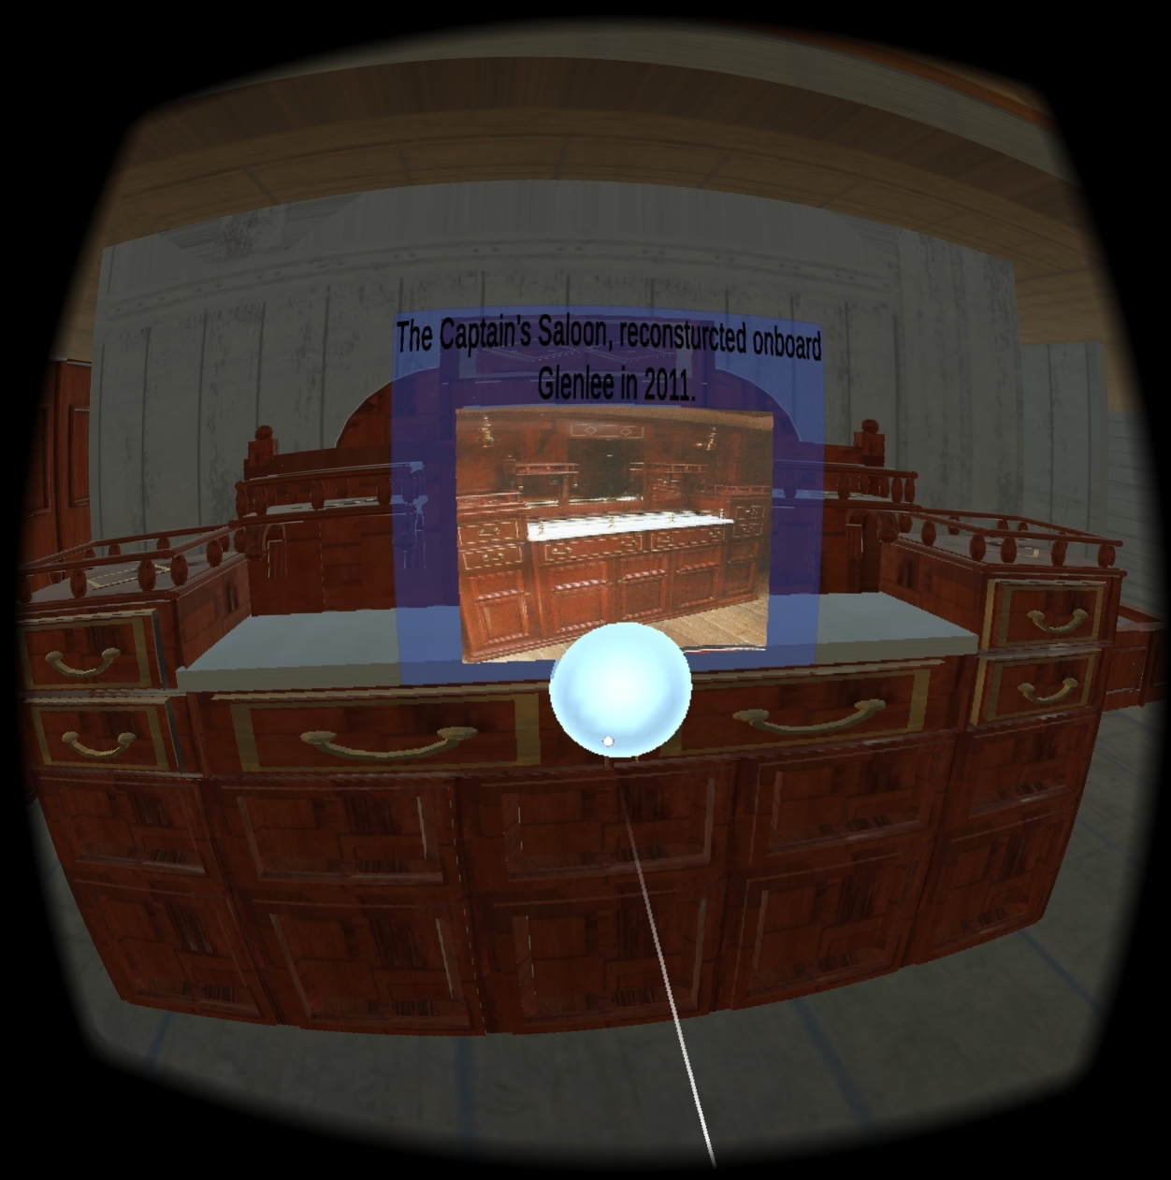
Spreading knowledge in the virtual officers’ deckhouse scene

Slide 13
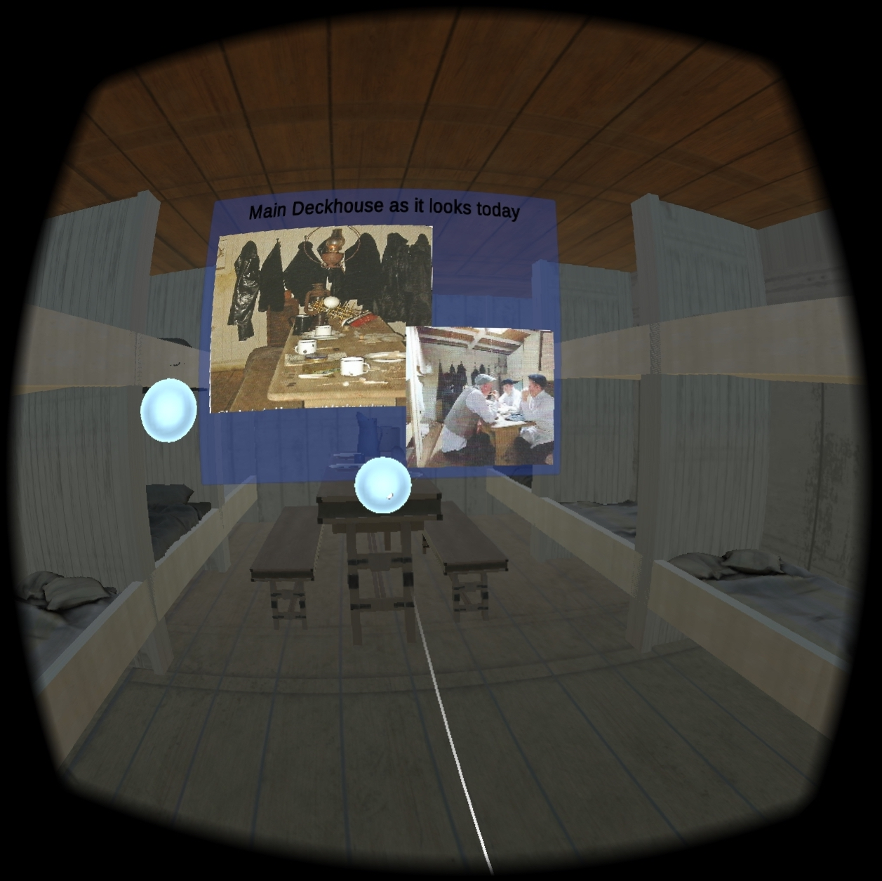
Spreading knowledge in the virtual main deckhouse scene

Slide 14
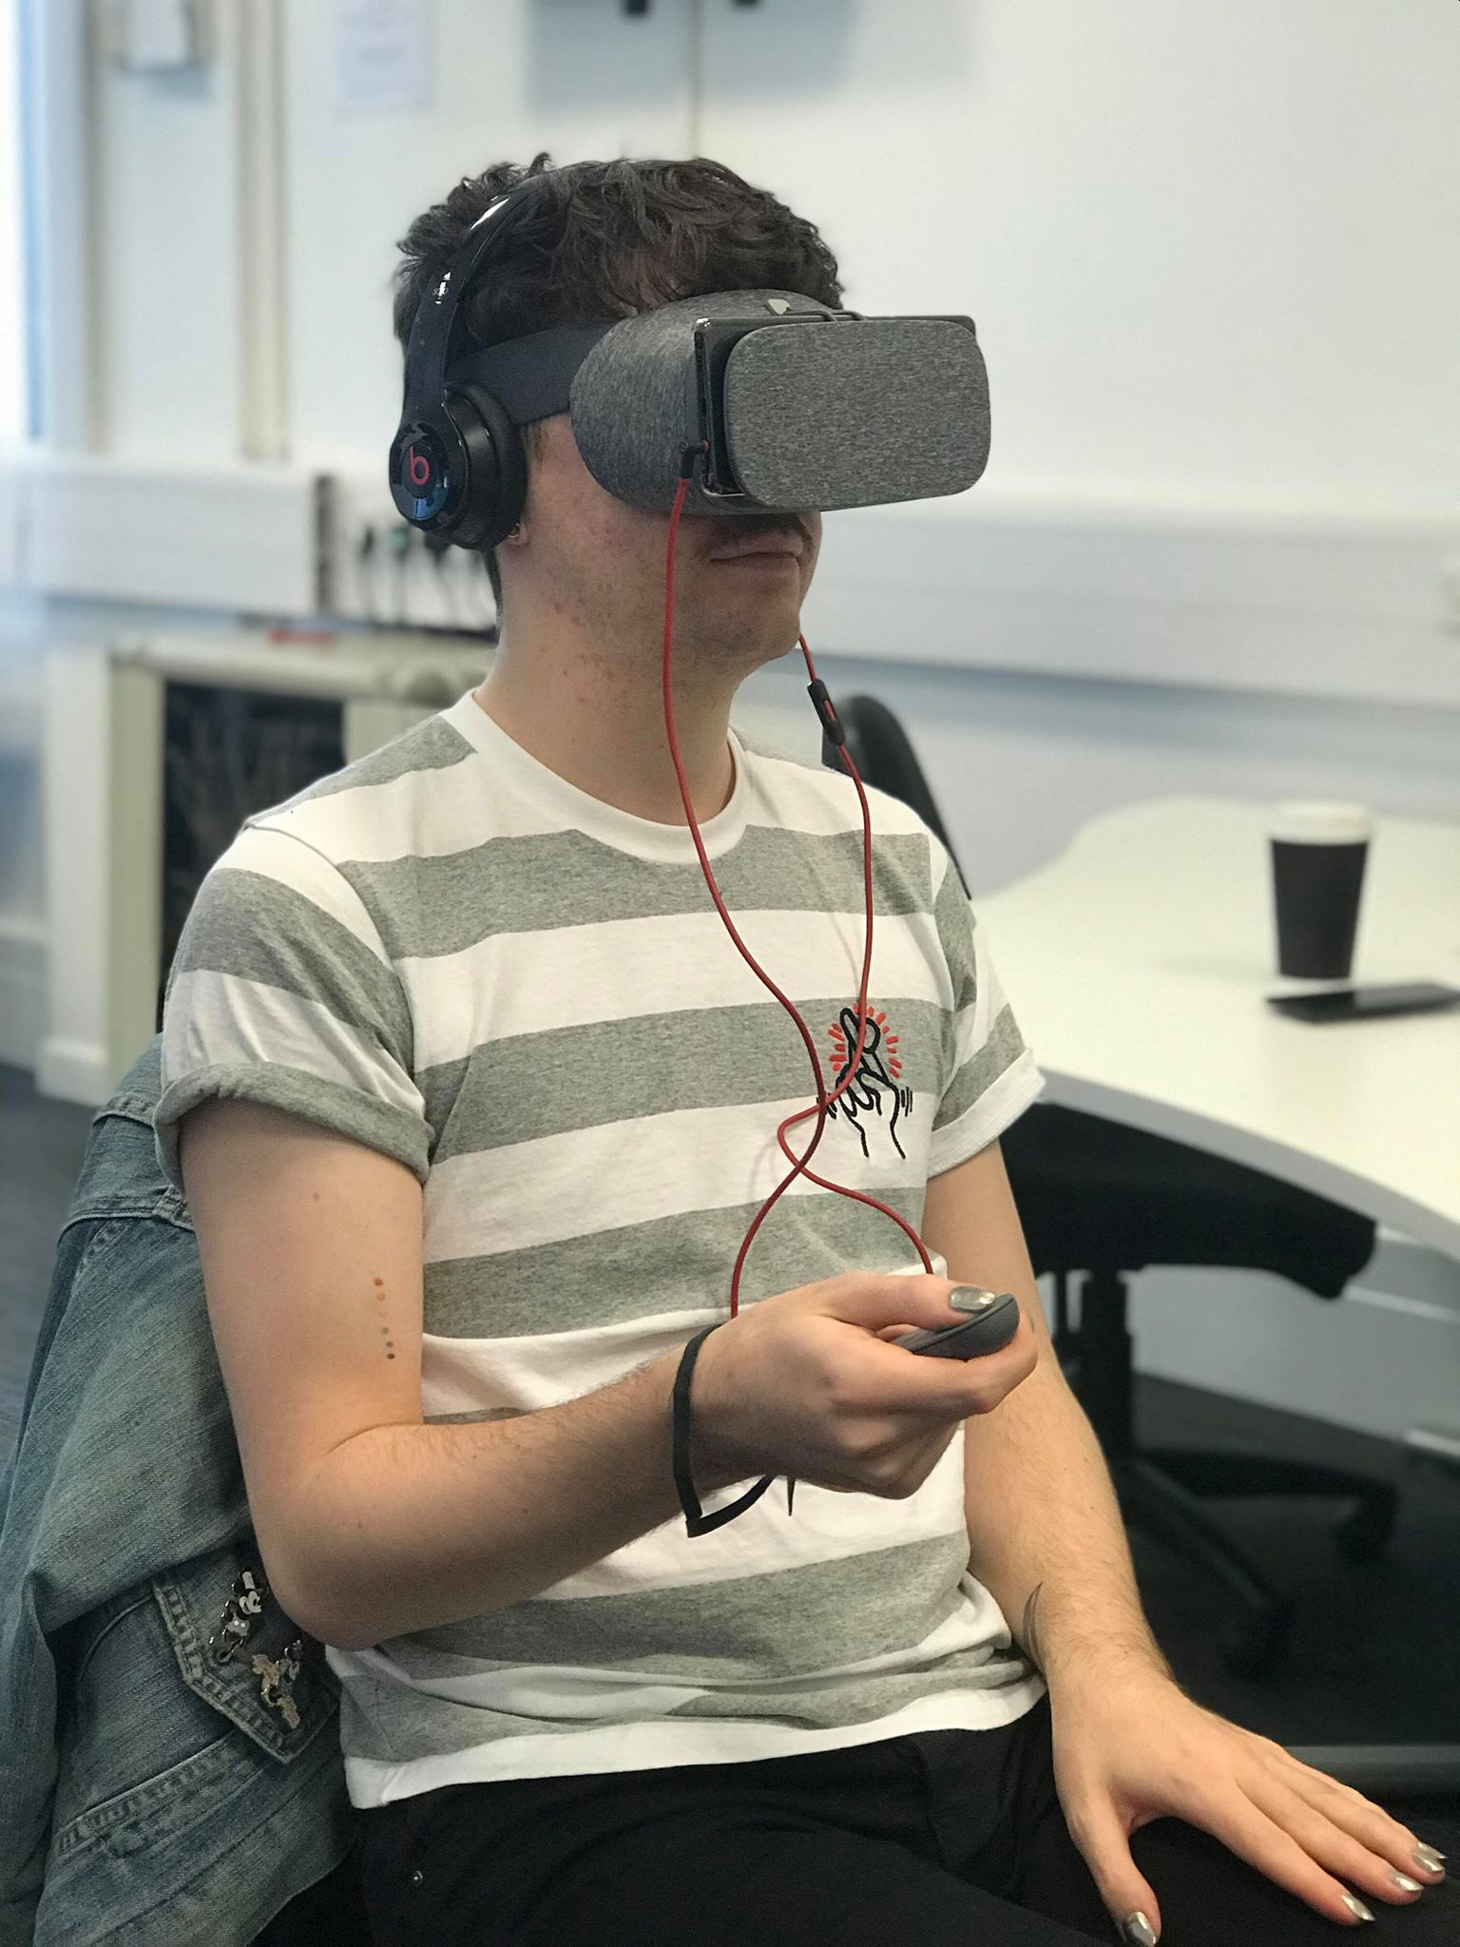
Evaluation
20 Participants
VR application effective at spreading knowledge
4.4/5 mean rating
Inspired to visit the museum ship
3.95/5 mean rating

Slide 15
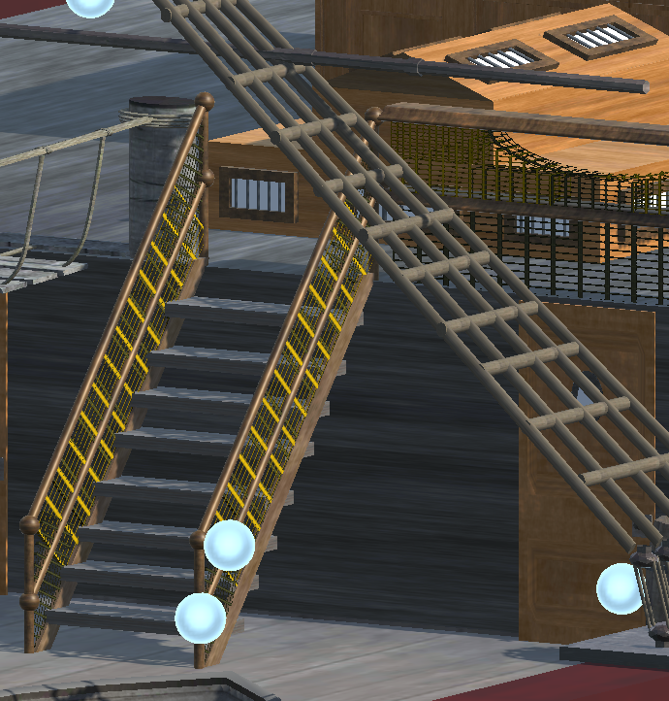
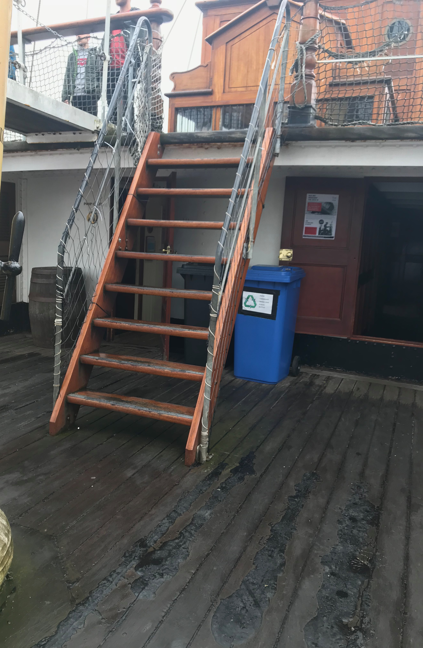
Evaluation
"I went on the ship, and this really does resemble it. I remember these steep steps!”
"Can't believe the captain brought his wife on board, poor woman!"

Slide 16
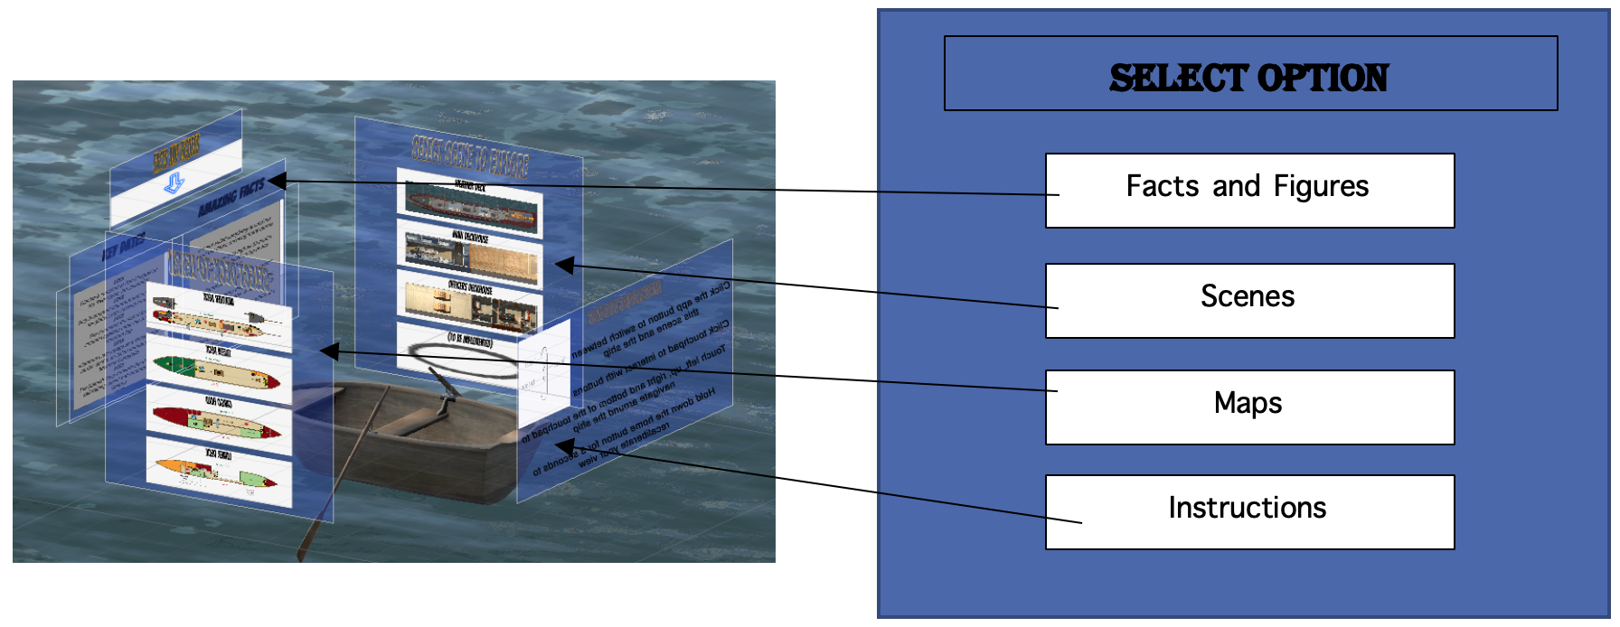
Future Enhancements
Simple tweaks in the map scene
Virtual Characters
Storytelling experience
Official Audiobooks

Slide 17
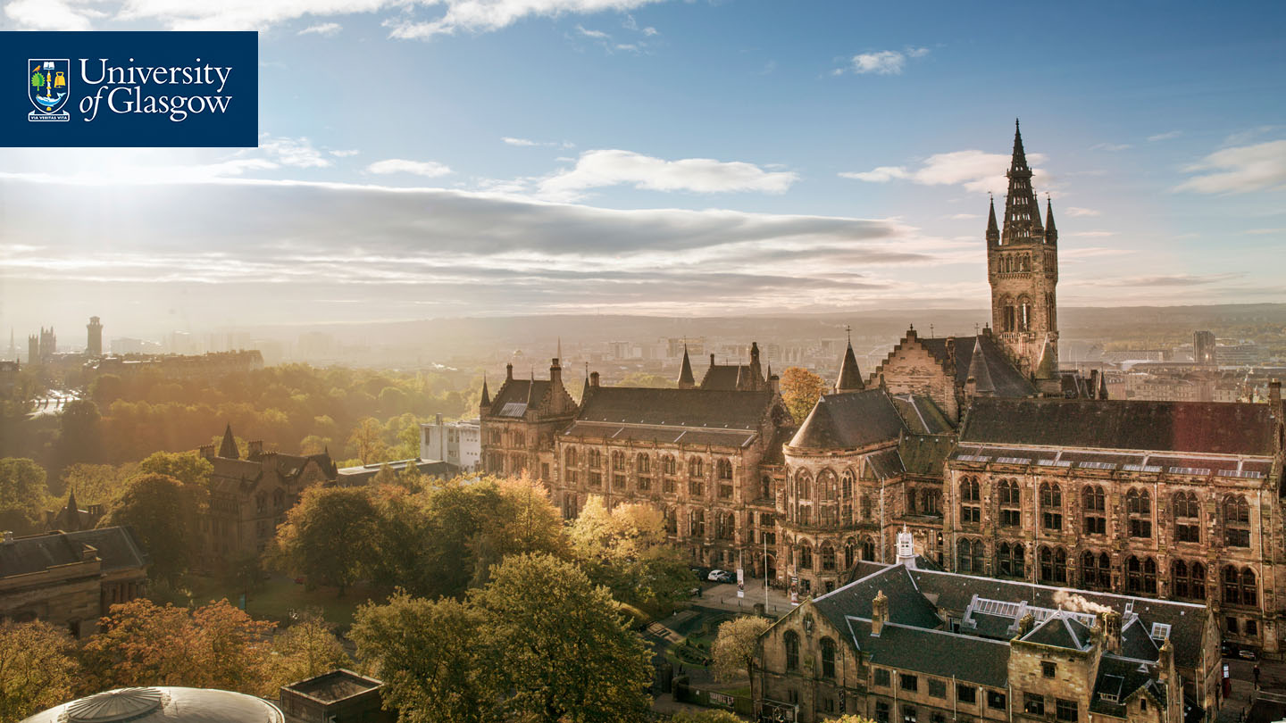
Thank you! Questions?

